Slide 1
UVa 911 Multinomial Coefficients

Slide 2
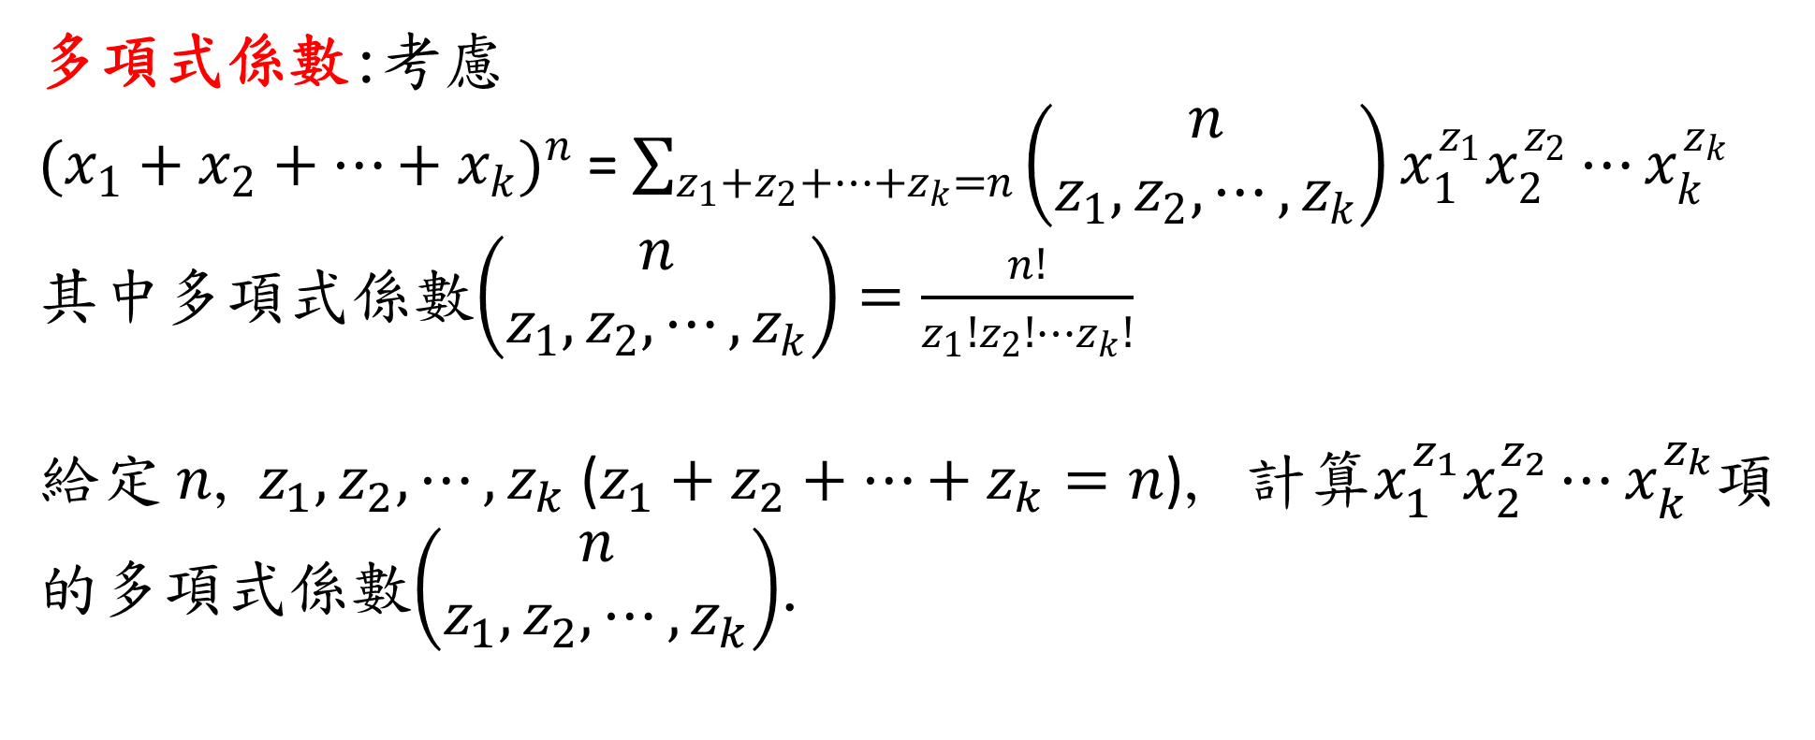
UVa 911 Multinomial Coefficients (Time Limit: 3 seconds)
多項式係數:考慮
${(x_{1}+x_{2}+⋯+x_{k})}^{n}$= $\sum_{z_{1}+z_{2}+⋯+z_{k}=n}{\left(\begin{matrix}n \\ z_{1},z_{2},⋯,z_{k}\end{matrix}\right)x_{1}^{z_{1}}x_{2}^{z_{2}}⋯x_{k}^{z_{k}}}$
其中多項式係數$\left(\begin{matrix}n \\ z_{1},z_{2},⋯,z_{k}\end{matrix}\right)=\frac{n!}{z_{1}!z_{2}!⋯z_{k}!}$
給定 $n$, $z_{1},z_{2},⋯,z_{k}$ ($z_{1}+z_{2}+⋯+z_{k}=n$), 計算$x_{1}^{z_{1}}x_{2}^{z_{2}}⋯x_{k}^{z_{k}}$項的多項式係數$\left(\begin{matrix}n \\ z_{1},z_{2},⋯,z_{k}\end{matrix}\right)$.

Slide 3
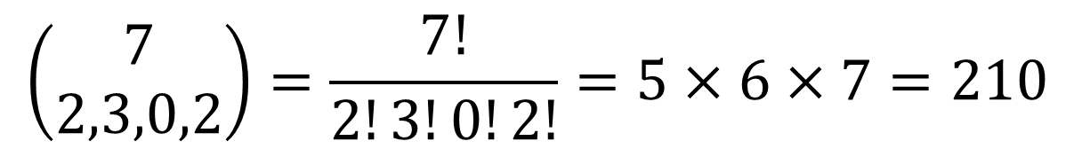
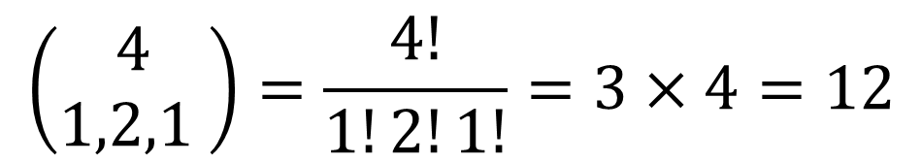
Examples:
Test Case #1
$$\left(\begin{matrix}4 \\ 1,2,1 \end{matrix}\right)=\frac{4!}{1!2!1!}=3×4=12$$
Test Case #2
$$\left(\begin{matrix}7 \\ 2,3,0,2\end{matrix}\right)=\frac{7!}{2!3!0!2!}=5×6×7=210$$

Slide 4
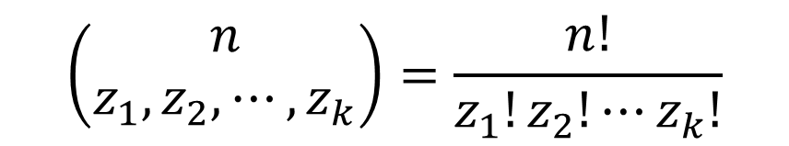

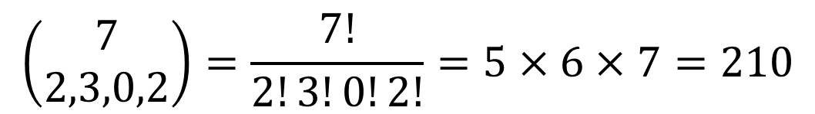
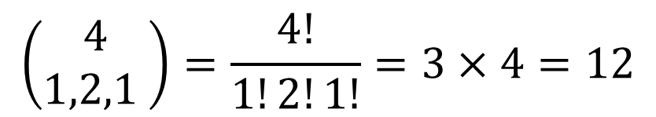

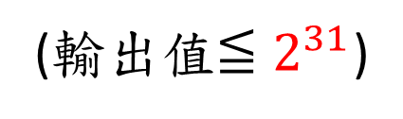

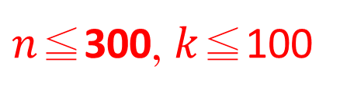
Sample Input
Sample Output
4
3
1 2 1
7
4
2 3 0 2
$$n$$
Test Case #1
12
210
$k$值
$$z_{1},z_{2},⋯,z_{k}$$
$$\left(\begin{matrix}n \\ z_{1},z_{2},⋯,z_{k}\end{matrix}\right)=\frac{n!}{z_{1}!z_{2}!⋯z_{k}!}$$
Test Case #2
$n$≦300, $k$≦100
(輸出值$≦2^{31}$)
Test Case #2
Test Case #1
$$\left(\begin{matrix}4 \\ 1,2,1 \end{matrix}\right)=\frac{4!}{1!2!1!}=3×4=12$$
$$\left(\begin{matrix}7 \\ 2,3,0,2\end{matrix}\right)=\frac{7!}{2!3!0!2!}=5×6×7=210$$

Slide 5
Solution
不可以直接計算n!帶入公式計算結果 (有整數overflow風險)
迂迴表示n!
善用一維陣列
利用最大公約數(gcd)將分母與分子共同因數消掉
除法運算

Slide 6
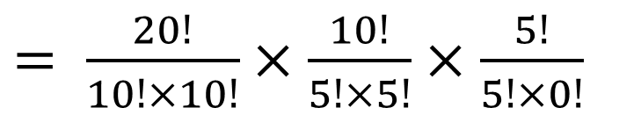

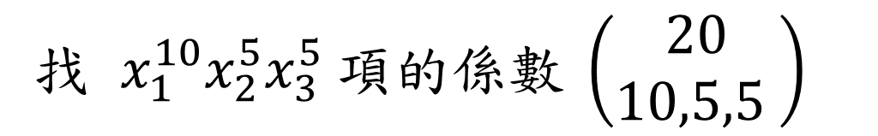

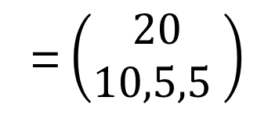
Multinomial Coefficients 例子
有20人要分成3個委員會,委員會人數分別為10人,5人,5人,請問共有幾種分法?
答案:
$$C_{10}^{20}∙C_{5}^{10}∙C_{5}^{5}$$
$= \frac{20!}{10!×10!}×\frac{10!}{5!×5!}$ $×\frac{5!}{5!×0!}$
= $\left(\begin{matrix}20 \\ 10,5,5 \end{matrix}\right)$
相當於從
$${\left(x_{1}+x_{2}+x_{3}\right)}^{20}$$
找 $x_{1}^{10}x_{2}^{5}x_{3}^{5} 項的係數 \left(\begin{matrix}20 \\ 10,5,5 \end{matrix}\right)$

Slide 7
演算法

Slide 8
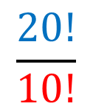
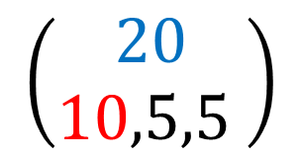
$$\left(\begin{matrix}20 \\ 10,5,5 \end{matrix}\right)$$
1 | 2 | 3 | 4 | 5 | 6 | 7 | 8 | 9 | 10 | 11 | 12 | 13 | 14 | 15 | 16 | 17 | 18 | 19 | 20
20!
1 | 2 | 3 | 4 | 5 | 6 | 7 | 8 | 9 | 10 | 11 | 12 | 13 | 14 | 15 | 16 | 17 | 18 | 19 | 20
1 | 2 | 3 | 4 | 5 | 6 | 7 | 8 | 9 | 10 | 11 | 12 | 13 | 14 | 15 | 16 | 17 | 18 | 19 | 20
$$\frac{20!}{10!}$$
/ 2
1 | 2 | 3 | 4 | 5 | 6 | 7 | 8 | 9 | 10 | 11 | 12 | 13 | 14 | 15 | 16 | 17 | 18 | 19 | 20
1 | 1 | 3 | 4 | 5 | 6 | 7 | 8 | 9 | 10 | 11 | 12 | 13 | 14 | 15 | 16 | 17 | 18 | 19 | 20
gcd(2,2)=2
/ 3
1 | 2 | 3 | 4 | 5 | 6 | 7 | 8 | 9 | 10 | 11 | 12 | 13 | 14 | 15 | 16 | 17 | 18 | 19 | 20
1 | 1 | 1 | 4 | 5 | 6 | 7 | 8 | 9 | 10 | 11 | 12 | 13 | 14 | 15 | 16 | 17 | 18 | 19 | 20
gcd(3,3)=3
/ 4
1 | 2 | 3 | 4 | 5 | 6 | 7 | 8 | 9 | 10 | 11 | 12 | 13 | 14 | 15 | 16 | 17 | 18 | 19 | 20
1 | 1 | 1 | 1 | 5 | 6 | 7 | 8 | 9 | 10 | 11 | 12 | 13 | 14 | 15 | 16 | 17 | 18 | 19 | 20
gcd(4,4)=4
/ 5
1 | 2 | 3 | 4 | 5 | 6 | 7 | 8 | 9 | 10 | 11 | 12 | 13 | 14 | 15 | 16 | 17 | 18 | 19 | 20
1 | 1 | 1 | 1 | 1 | 6 | 7 | 8 | 9 | 10 | 11 | 12 | 13 | 14 | 15 | 16 | 17 | 18 | 19 | 20
gcd(5,5)=5

Slide 9
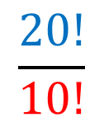
$$\left(\begin{matrix}20 \\ 10,5,5 \end{matrix}\right)$$
1 | 2 | 3 | 4 | 5 | 6 | 7 | 8 | 9 | 10 | 11 | 12 | 13 | 14 | 15 | 16 | 17 | 18 | 19 | 20
1 | 1 | 1 | 1 | 1 | 6 | 7 | 8 | 9 | 10 | 11 | 12 | 13 | 14 | 15 | 16 | 17 | 18 | 19 | 20
/ 5
$$\frac{20!}{10!}$$
1 | 2 | 3 | 4 | 5 | 6 | 7 | 8 | 9 | 10 | 11 | 12 | 13 | 14 | 15 | 16 | 17 | 18 | 19 | 20
1 | 1 | 1 | 1 | 1 | 1 | 7 | 8 | 9 | 10 | 11 | 12 | 13 | 14 | 15 | 16 | 17 | 18 | 19 | 20
/ 6
gcd(6,6)=6
/ 7
1 | 2 | 3 | 4 | 5 | 6 | 7 | 8 | 9 | 10 | 11 | 12 | 13 | 14 | 15 | 16 | 17 | 18 | 19 | 20
1 | 1 | 1 | 1 | 1 | 1 | 1 | 8 | 9 | 10 | 11 | 12 | 13 | 14 | 15 | 16 | 17 | 18 | 19 | 20
gcd(7,7)=2
/ 8
1 | 2 | 3 | 4 | 5 | 6 | 7 | 8 | 9 | 10 | 11 | 12 | 13 | 14 | 15 | 16 | 17 | 18 | 19 | 20
1 | 1 | 1 | 1 | 1 | 1 | 1 | 1 | 9 | 10 | 11 | 12 | 13 | 14 | 15 | 16 | 17 | 18 | 19 | 20
gcd(8,8)=8
/ 9
1 | 2 | 3 | 4 | 5 | 6 | 7 | 8 | 9 | 10 | 11 | 12 | 13 | 14 | 15 | 16 | 17 | 18 | 19 | 20
1 | 1 | 1 | 1 | 1 | 1 | 1 | 1 | 1 | 10 | 11 | 12 | 13 | 14 | 15 | 16 | 17 | 18 | 19 | 20
gcd(9,9)=9
/ 10
1 | 2 | 3 | 4 | 5 | 6 | 7 | 8 | 9 | 10 | 11 | 12 | 13 | 14 | 15 | 16 | 17 | 18 | 19 | 20
1 | 1 | 1 | 1 | 1 | 1 | 1 | 1 | 1 | 1 | 11 | 12 | 13 | 14 | 15 | 16 | 17 | 18 | 19 | 20
gcd(10,10)=10

Slide 10
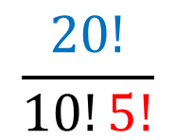
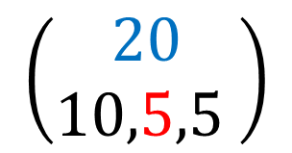
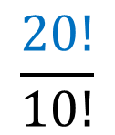
$$\left(\begin{matrix}20 \\ 10,5,5 \end{matrix}\right)$$
$$\frac{20!}{10!}$$
1 | 2 | 3 | 4 | 5 | 6 | 7 | 8 | 9 | 10 | 11 | 12 | 13 | 14 | 15 | 16 | 17 | 18 | 19 | 20
1 | 1 | 1 | 1 | 1 | 1 | 1 | 1 | 1 | 1 | 11 | 12 | 13 | 14 | 15 | 16 | 17 | 18 | 19 | 20
$$\frac{20!}{10!5!}$$
1 | 2 | 3 | 4 | 5 | 6 | 7 | 8 | 9 | 10 | 11 | 12 | 13 | 14 | 15 | 16 | 17 | 18 | 19 | 20
1 | 1 | 1 | 1 | 1 | 1 | 1 | 1 | 1 | 1 | 11 | 6 | 13 | 14 | 15 | 16 | 17 | 18 | 19 | 20
/ 2
gcd(12,2)=2
/ 3
1 | 2 | 3 | 4 | 5 | 6 | 7 | 8 | 9 | 10 | 11 | 12 | 13 | 14 | 15 | 16 | 17 | 18 | 19 | 20
1 | 1 | 1 | 1 | 1 | 1 | 1 | 1 | 1 | 1 | 11 | 2 | 13 | 14 | 15 | 16 | 17 | 18 | 19 | 20
gcd(6,3)=3
/ 4
1 | 2 | 3 | 4 | 5 | 6 | 7 | 8 | 9 | 10 | 11 | 12 | 13 | 14 | 15 | 16 | 17 | 18 | 19 | 20
1 | 1 | 1 | 1 | 1 | 1 | 1 | 1 | 1 | 1 | 11 | 1 | 13 | 7 | 15 | 16 | 17 | 18 | 19 | 20
gcd(2,4)=2
gcd(14,2)=2
/ 5
1 | 2 | 3 | 4 | 5 | 6 | 7 | 8 | 9 | 10 | 11 | 12 | 13 | 14 | 15 | 16 | 17 | 18 | 19 | 20
1 | 1 | 1 | 1 | 1 | 1 | 1 | 1 | 1 | 1 | 11 | 1 | 13 | 7 | 3 | 16 | 17 | 18 | 19 | 20
gcd(15,5)=5

Slide 11
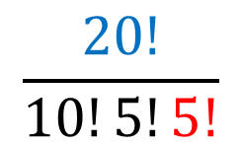
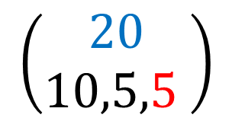
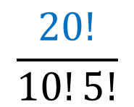
$$\left(\begin{matrix}20 \\ 10,5,5 \end{matrix}\right)$$
$$\frac{20!}{10!5!}$$
1 | 2 | 3 | 4 | 5 | 6 | 7 | 8 | 9 | 10 | 11 | 12 | 13 | 14 | 15 | 16 | 17 | 18 | 19 | 20
1 | 1 | 1 | 1 | 1 | 1 | 1 | 1 | 1 | 1 | 11 | 1 | 13 | 7 | 3 | 16 | 17 | 18 | 19 | 20
$$\frac{20!}{10!5!5!}$$
1 | 2 | 3 | 4 | 5 | 6 | 7 | 8 | 9 | 10 | 1 | 12 | 13 | 14 | 15 | 16 | 17 | 18 | 19 | 20
1 | 1 | 1 | 1 | 1 | 1 | 1 | 1 | 1 | 1 | 1 | 1 | 13 | 7 | 3 | 8 | 17 | 18 | 19 | 20
/ 2
gcd(16,2)=2
/ 3
1 | 2 | 3 | 4 | 5 | 6 | 7 | 8 | 9 | 10 | 11 | 12 | 13 | 14 | 15 | 16 | 17 | 18 | 19 | 20
1 | 1 | 1 | 1 | 1 | 1 | 1 | 1 | 1 | 1 | 11 | 1 | 13 | 7 | 1 | 8 | 17 | 18 | 19 | 20
gcd(3,3)=3
/ 4
1 | 2 | 3 | 4 | 5 | 6 | 7 | 8 | 9 | 10 | 11 | 12 | 13 | 14 | 15 | 16 | 17 | 18 | 19 | 20
1 | 1 | 1 | 1 | 1 | 1 | 1 | 1 | 1 | 1 | 11 | 1 | 13 | 7 | 1 | 2 | 17 | 18 | 19 | 20
gcd(8,4)=4
/ 5
1 | 2 | 3 | 4 | 5 | 6 | 7 | 8 | 9 | 10 | 11 | 12 | 13 | 14 | 15 | 16 | 17 | 18 | 19 | 20
1 | 1 | 1 | 1 | 1 | 1 | 1 | 1 | 1 | 1 | 11 | 1 | 13 | 7 | 1 | 2 | 17 | 18 | 19 | 4
gcd(20,5)=5
$$\left(\begin{matrix}20 \\ 10,5,5\end{matrix}\right)=\frac{20!}{10!5!5!}=11×1×13×7×1×2×17×18×19×4=46558512$$
最後

Slide 12
除法運算

Slide 13
用除以4運算為例
1 | 2 | 3 | 4 | 5 | 6 | 7 | 8 | 9 | 10 | 11 | 12 | 13 | 14 | 15 | 16 | 17 | 18 | 19 | 20
1 | 1 | 1 | 1 | 1 | 1 | 1 | 1 | 1 | 1 | 11 | 2 | 13 | 14 | 15 | 16 | 17 | 18 | 19 | 20
/ 4
自左而右先找與4的gcd值不為1處
gcd(2,4)=2
除以gcd(2,4)
4消去gcd(2,4)因數後剩下2
1 | 2 | 3 | 4 | 5 | 6 | 7 | 8 | 9 | 10 | 11 | 12 | 13 | 14 | 15 | 16 | 17 | 18 | 19 | 20
1 | 1 | 1 | 1 | 1 | 1 | 1 | 1 | 1 | 1 | 11 | 1 | 13 | 14 | 15 | 16 | 17 | 18 | 19 | 20
再繼續往右找與2的gcd值不為1處
gcd(14,2)=2
除以gcd(14,2)
1 | 2 | 3 | 4 | 5 | 6 | 7 | 8 | 9 | 10 | 11 | 12 | 13 | 14 | 15 | 16 | 17 | 18 | 19 | 20
1 | 1 | 1 | 1 | 1 | 1 | 1 | 1 | 1 | 1 | 11 | 1 | 13 | 7 | 15 | 16 | 17 | 18 | 19 | 20
結果
2消去gcd(14,2)因數後剩下1
除法運算結束

Slide 14
UVa 911 Code (1/3)
#include <stdio.h>
int gcd(int x, int y) // 用輾轉相除法找x,y最大公約數 gcd(x,y)
{
int t;
while(x%y)
t = x, x = y, y = t%y;
return y;
}

Slide 15
int main() {
int i, j, k, n, m, x;
freopen("911.in","r",stdin); freopen("911.out","w",stdout);
while(scanf("%d %d", &n, &m) == 2) {
int A[305], sum = 0; // array A:存n!之後存被分母消去因數後結果
for(i = 1; i <= n; i++) A[i] = i; // 存n!
while(m--) {
scanf("%d", &x); sum += x;
for(i = 2; i <= x; i++) { // 計算陣列A除以x!結果
j = i; //計算陣列A除以j
for(k = 2; k <= n; k++) { // A陣列從左至右找與j之gcd值不為1處
int g = gcd(A[k], j);
if (g==1) continue; // gcd=1則A陣列繼續往右找
A[k] /= g; // A[k]值消去gcd值(與j最大公約數) 因數
j /= g; // j值消去gcd值(與A[k]最大公約數) 因數
if (j==1) break; // 若j=1,則除以j運算結束
}
}
}
UVa 911 Code (2/3)

Slide 16
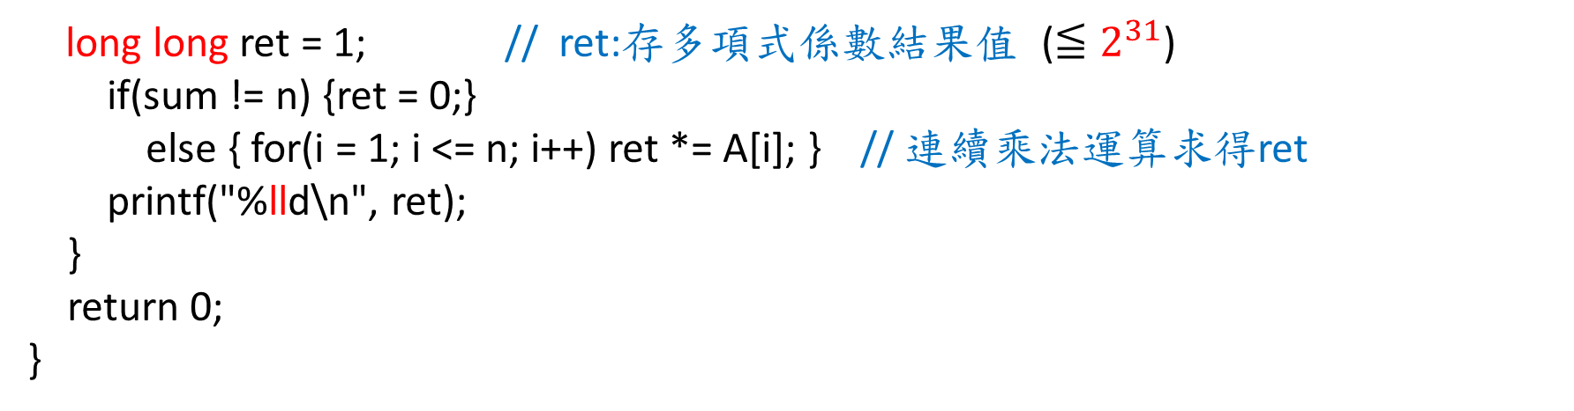
UVa 911 Code (3/3)
long long ret = 1; // ret:存多項式係數結果值 ($≦2^{31}$)
if(sum != n) {ret = 0;}
else { for(i = 1; i <= n; i++) ret *= A[i]; } // 連續乘法運算求得ret
printf("%lld\n", ret);
}
return 0;
}

